Slide 1

Quantum Computing
9. Quantum algorithms (1)
Quantum Computing Insitute
https://qcict.org
Prof. Aleksandar Radovanovic
alex@qcict.org

Slide 2
Content
3. Bernstein–Vazirani algorithm
2. Deutsch–Jozsa algorithm
4. Simon’s algorithm
1. Deutsch algorithm

Slide 3
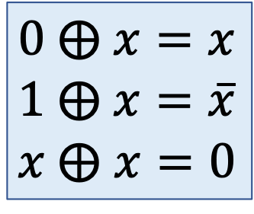
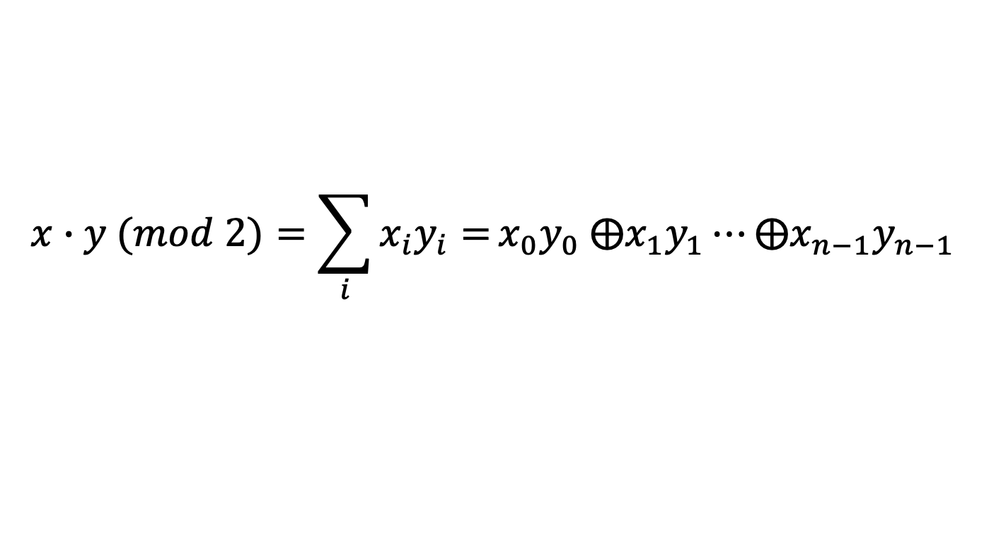
MathBox: Modulo-2 Addition / XOR operation
①
②
a | b | a ⨁ b
0 | 0 | 0
0 | 1 | 1
1 | 0 | 1
1 | 1 | 0
$0 ⨁$ $x=x$
$1 ⨁$ $x=\overline{x}$
$x ⨁$ $x=0$
Example : 111 ⨁ 101 = 010
$$x∙y (mod 2)=\sum_{i}{x_{i}y_{i}=}x_{0}y_{0} {⨁x}_{1}y_{1}⋯{⨁x}_{n−1}y_{n−1}$$
③
Example:
101 ∙ 110 = (1 ∙ 1) ⊕ (0 ∙ 1) ⊕ (1 ∙ 0) = 1 ⊕ 0 ⊕ 0 = 1
Notes:
The XOR Boolean operation is often used in quantum algorithms.
XOR gives 1 when the two inputs are different and 0 when they are the same. It can also be viewed as addition modulo 2. For example, 1⊕1=0, because the carry bit is ignored in single-bit addition.
Using a Boolean variable $x$, some useful XOR identities are: $0 ⨁$ $x=x$, $1 ⨁$ $x=\overline{x}$ and $x ⨁$ $x=0$
Another important operation is the inner product of two Boolean vectors. It is defined as the modulo-2 sum, or XOR, of the logical ANDs of their corresponding elements.

Slide 4

Recap: Quantum Oracle
$$f\left(x\right):{\left\{0,1\right\}}^{n}→\left\{0,1\right\}$$
n
input/output register
$$\left.|x\right\rangle$$
$$\left.|x\right\rangle$$
O
auxiliary (ancillary)
input/output register
$$\left.|y\right\rangle$$
$$\left.|y ⨁\left. f(x\right)\right\rangle$$
$$O:\left|x\right\rangle \left|y\right\rangle →\left|x\right\rangle \left|y⨁f\left(x\right)\right\rangle$$
Binary oracle: $y$= $\left|0\right\rangle$:
Phase oracle: $y$= $\left|−\right\rangle$:
$$\left|x\right\rangle \left|0\right\rangle →\left|x\right\rangle \left|0⨁f\left(x\right)\right\rangle =\left|x\right\rangle \left|f\left(x\right)\right\rangle$$
$$\left|x\right\rangle \left|−\right\rangle →{(−1)}^{f(x)}\left|x\right\rangle \left|−\right\rangle$$
$$\text{provides} \text{function} \text{values}$$
$$\text{marks} \text{solutions}$$
Notes:
A quantum oracle is like a black box that hides a function inside it. We do not need to know how the function is implemented internally; we only need to know how it maps inputs to outputs. In many quantum algorithms, the oracle represents a Boolean function that takes an n-bit input and produces either 0 or 1.
The oracle is implemented as a unitary operation acting on two registers: one holding the input $\left.|x\right\rangle$, and the other holding an auxiliary qubit $\left.|y\right\rangle$. Its action is:
$$\left|x\right\rangle \left|y\right\rangle →\left|x\right\rangle \left|y⨁f\left(x\right)\right\rangle$$
Here, $\left|x\right\rangle$ is left unchanged, while $\left|y\right\rangle$ is flipped if $f\left(x\right)=1$, and remains unchanged if $f\left(x\right)=0$.
If the auxiliary qubit is set to ∣0⟩, the oracle operates as a binary oracle. The oracle stores the function value $f\left(x\right)$ in the auxiliary qubit. This allows us to evaluate the function for the input $x$.
If the auxiliary qubit is set to ∣–⟩, the oracle operates as a phase oracle. The oracle doesn’t output the value directly, but instead adds a phase of $(−1)$ whenever $f\left(x\right)=1$In other words, it marks the inputs for which the function evaluates to TRUE.
More generally, the oracle can use a multi-qubit auxiliary register when the function produces more than one output bit.

Slide 5
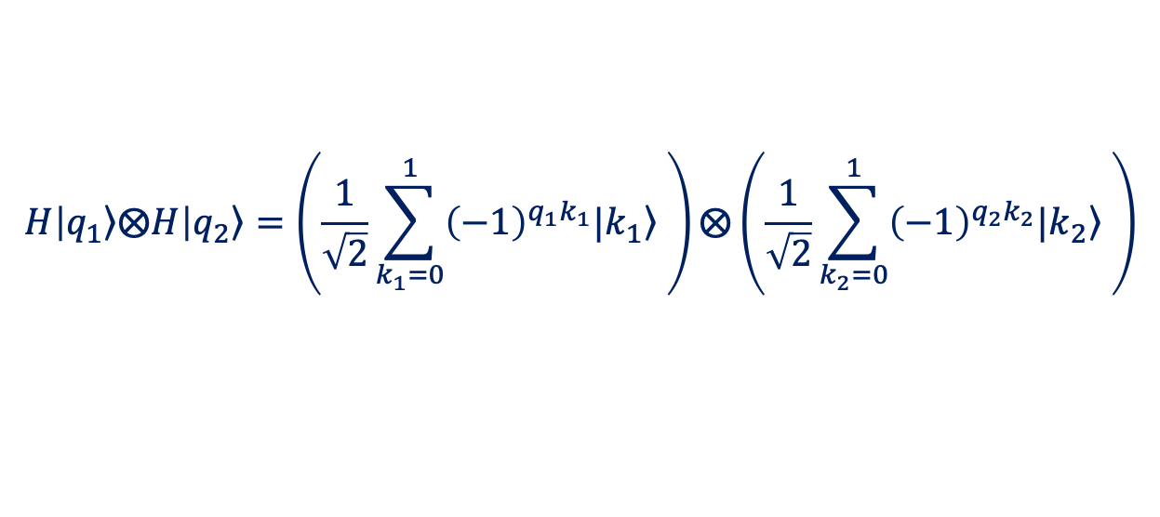
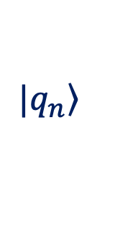
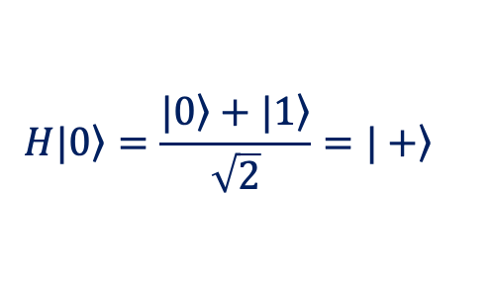

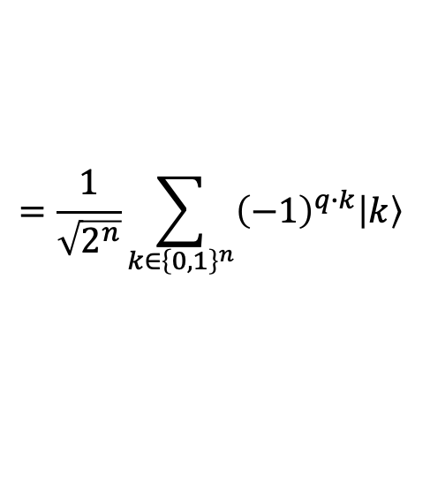

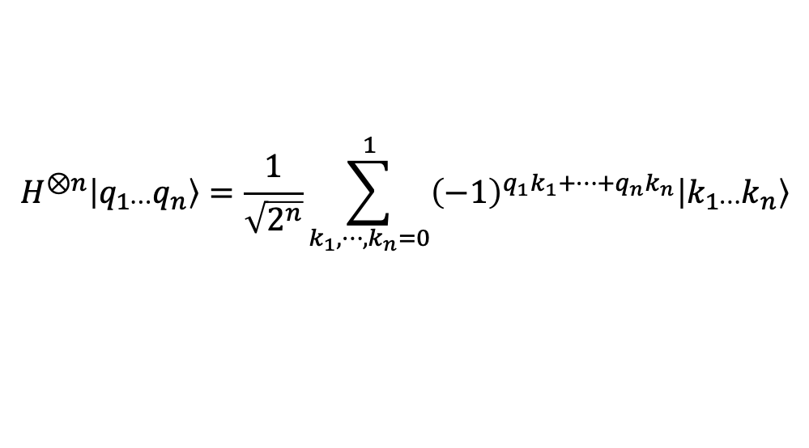


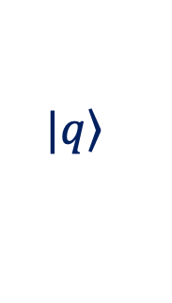
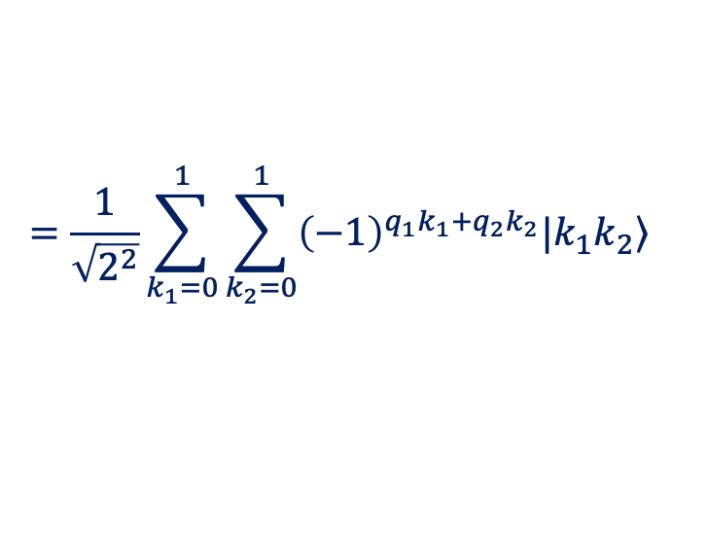
Recap: Superposition
$$|\left.q\right\rangle$$
$$H|\left.0\right\rangle =\frac{\left.|0\right\rangle +\left.|1\right\rangle }{\sqrt{2}}=\left.|+\right\rangle$$
$$H|\left.q\right\rangle =\frac{1}{\sqrt{2}}\sum_{k=0}^{1}{{\left(−1\right)}^{qk}|\left.k\right\rangle \text{,} } ∀q,k∈\left\{0,1\right\}$$
H
$$H|\left.1\right\rangle =\frac{\left.|0\right\rangle −\left.|1\right\rangle }{\sqrt{2}}=\left.|−\right\rangle$$
$$H\left|\left.q_{1}\right\rangle ⨂H\right|\left.q_{2}\right\rangle =\left(\frac{1}{\sqrt{2}}\sum_{k_{1}=0}^{1}{{\left(−1\right)}^{q_{1}k_{1}}|\left.k_{1}\right\rangle }\right)⨂\left(\frac{1}{\sqrt{2}}\sum_{k_{2}=0}^{1}{{\left(−1\right)}^{q_{2}k_{2}}|\left.k_{2}\right\rangle }\right)$$
$$|\left.q_{1}\right\rangle$$
H
$$=\frac{1}{\sqrt{2^{2}}}\sum_{k_{1}=0}^{1}{\sum_{k_{2}=0}^{1}{{\left(−1\right)}^{q_{1}k_{1}+q_{2}k_{2}}|\left.k_{1}k_{2}\right\rangle }}$$
$$|\left.q_{2}\right\rangle$$
H
$$H^{⊗n}\left|q_{1⋯}q_{n}\right\rangle =\frac{1}{\sqrt{2^{n}}}\sum_{k_{1},⋯,k_{n}=0}^{1}{{\left(−1\right)}^{{q_{1}k_{1}+⋯+q}_{n}k_{n}}\left|k_{1⋯}k_{n}\right\rangle }$$
$$|\left.q_{n}\right\rangle$$
$$=\frac{1}{\sqrt{2^{n}}}\sum_{k∈{\left\{0,1\right\}}^{n}}{{\left(−1\right)}^{q∙k}\left|k\right\rangle }$$
H
Notes:
One of the key properties used in quantum algorithms is superposition. Many quantum algorithms begin by creating an equal superposition of all computational basis states, which can be achieved by applying Hadamard gates to all qubits.
A single qubit can be placed in an equal superposition of its basis states denoted as $\left.|+\right\rangle$ and $\left.|−\right\rangle .$
The superposition of two qubits can be obtained as the Kronecker product of their individual superposition states.
Similarly, the superposition of n qubits can be obtained by taking the Kronecker product of their individual superposition states. This produces a sum over all possible n-bit basis states. Each basis state has the same amplitude magnitude, while its phase is determined by the bitwise inner product q⋅k of the initial bit string q with the basis state k, calculated modulo 2.

Slide 6

Deutsch algorithm
(1985)
David Deutsch (born 1953)
D. Deutsch, “Quantum theory, the Church–Turing principle and the universal quantum computer,” Proceedings of the Royal Society of London A, vol. 400, no. 1818, pp. 97–117, 1985.
Notes:
David Deutsch’s algorithm, published in 1985, is generally considered the first quantum algorithm. With this algorithm, Deutsch demonstrated how the principles of quantum superposition and interference could be used to solve computational problems.
His work played a major role in establishing the foundations of quantum computing as a scientific discipline and contributed to the later development of practical quantum computers.
Today, the algorithm is mainly of theoretical importance, but the principles of superposition and interference that it demonstrates remain fundamental to many modern quantum algorithms.

Slide 7


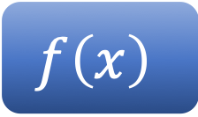

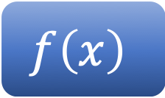


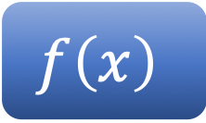


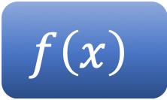

Informal Problem Description
0
0
1
1
1
1
0
0
$$x$$
$$f\left(0\right)=f\left(1\right)=0$$
$$x$$
$$f\left(0\right)=f\left(1\right)=1$$
$$f\left(x\right)$$
$$f\left(x\right)$$
0
0
0
0
1
1
1
1
Constant
Constant
0
0
1
1
1
1
0
$$f\left(0\right)=0, f\left(1\right)=1$$
0
$$f\left(0\right)=1, f\left(1\right)=0$$
$$x$$
$$x$$
$$f\left(x\right)$$
$$f\left(x\right)$$
0
1
1
0
1
0
0
1
Balanced
Balanced
Notes:
Imagine you have a mysterious machine that takes a binary input x, either 0 or 1, and produces a single-bit output $f\left(x\right)$. The machine can behave in two possible ways:
Constant machine: No matter what you put in, the output is always the same. It will always give 0 or always give 1.
Balanced machine: half of all possible inputs give 0, and half give 1.
The challenge, known as Deutsch’s problem, is this: using the machine as few times as possible, can we determine whether it is constant or balanced?
Classically, determining whether the machine is constant or balanced requires evaluating the function for both inputs, 0 and 1. Deutsch showed that a quantum computer can use superposition and interference to determine whether the function is constant or balanced with a single evaluation of the function. This was the first demonstration of how quantum computation can solve a problem using fewer function evaluations than a classical deterministic approach.

Slide 8
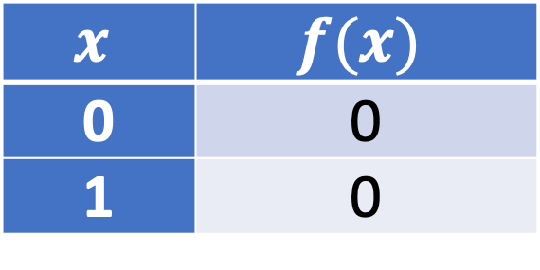
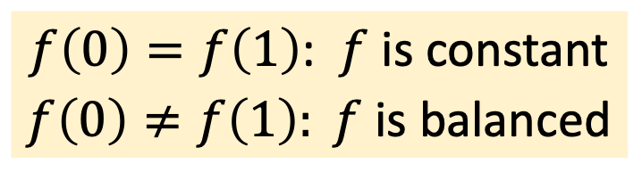
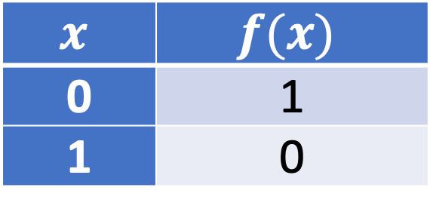
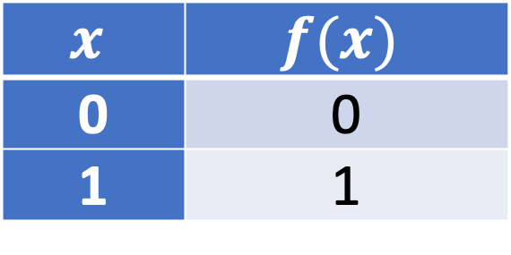
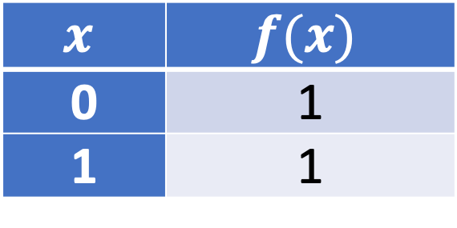
Constant and Balanced Functions
Constant function
$$x$$ | $$f(x)$$
0 | 0
1 | 0
$$x$$ | $$f(x)$$
0 | 1
1 | 1
I
II
OR
Balanced function
$$x$$ | $$f(x)$$
0 | 0
1 | 1
$$x$$ | $$f(x)$$
0 | 1
1 | 0
III
IV
OR
$f\left(0\right)=f\left(1\right)$: $f$ is constant
$f\left(0\right)≠f\left(1\right): f$ is balanced
Notes:
The behaviour of this unknown function $f\left(x\right)$, can be classified into four distinct cases:
Type I – Constant function (output is always 0): $f\left(0\right)=f\left(1\right)=0$
Type II – Constant function (output is always 1): $f\left(0\right)=f\left(1\right)=1$
Type III – Balanced function (output equals the input): $f\left(0\right)=0$, $f\left(1\right)=1$
Type IV – Balanced function (output is the opposite of the input): $f\left(0\right)=1$, $f\left(1\right)=0$
Conclusion:
If $f\left(0\right)=f\left(1\right)$, then $f$ is a constant function, since the output does not depend on the input.
If $f\left(0\right)≠f\left(1\right)$, then $f$ is a balanced function, since it produces one 0 and one 1 across the two inputs.

Slide 9
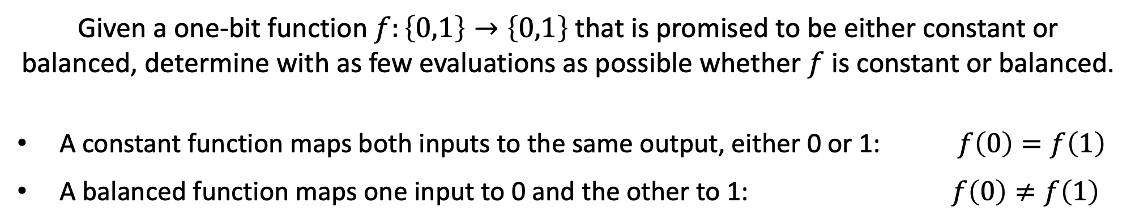
Formulation of Deutsch’s Problem
Constant
or
Balanced ?
Given a one-bit function $f:\left\{0,1\right\}→\left\{0,1\right\}$ that is promised to be either constant or balanced, determine with as few evaluations as possible whether $f$ is constant or balanced.
A constant function maps both inputs to the same output, either 0 or 1: $f\left(0\right)=f\left(1\right)$
A balanced function maps one input to 0 and the other to 1: $f\left(0\right)≠f\left(1\right)$
Notes:
Deutsch problem can be formulated as follows:
Given a one-bit function $f:\left\{0,1\right\}→\left\{0,1\right\}$ that is promised to be either constant or balanced, determine with as few evaluations as possible whether $f$ is constant or balanced.
A constant function maps both inputs to the same output, either 0 or 1: $f\left(0\right)=f\left(1\right)$
A balanced function maps one input to 0 and the other to 1: $f\left(0\right)≠f\left(1\right)$

Slide 10
Classical vs Quantum Solution
classical solution
quantum solution
The function is evaluated twice:
If both outputs are the same, the function is constant.
If the outputs are different, the function is balanced.
The function is evaluated only once, with the input in superposition.
If the output is 0, the function is constant.
If the output is 1, the function is balanced.
Notes:
In the classical solution, the function must be evaluated twice, once for each input:
If both outputs are the same, the function is constant.
If the outputs are different, the function is balanced.
In the quantum solution, the function is evaluated only once, with the input in superposition:
If the measurement outcome is 0, the function is constant.
If the measurement outcome is 1, the function is balanced.

Slide 11
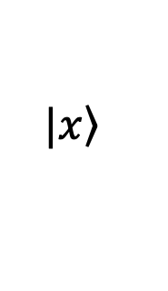
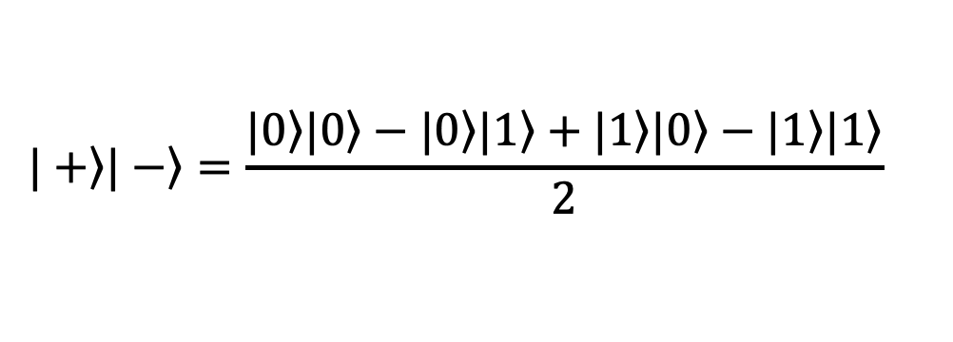
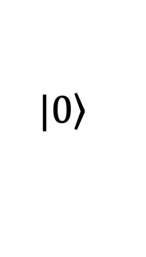
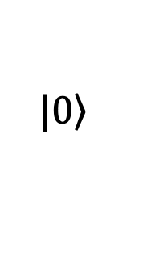
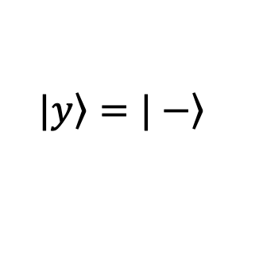
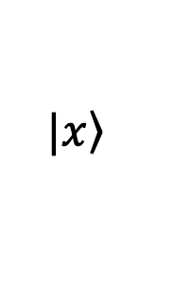
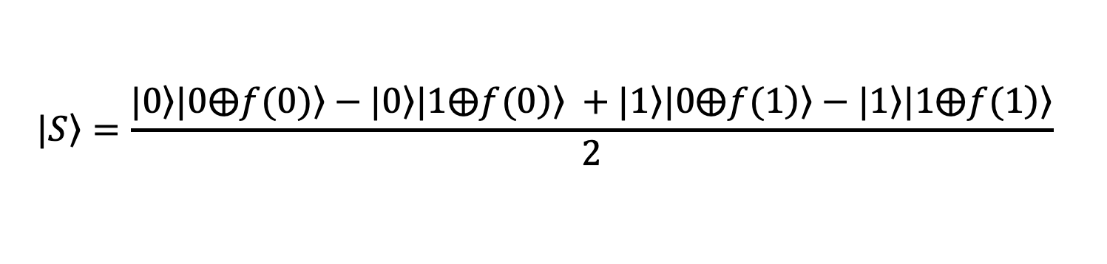
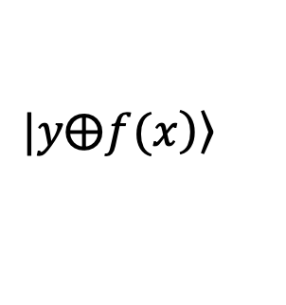
Deutsch’s Algorithm Implementation
$$\left.|+\right\rangle \left.|−\right\rangle =\frac{\left.|0\right\rangle \left.|0\right\rangle −\left.|0\right\rangle \left.|1\right\rangle +\left.|1\right\rangle \left.|0\right\rangle −\left.|1\right\rangle \left.|1\right\rangle }{2}$$
$$\left.|0\right\rangle$$
H
$$\left.|x\right\rangle$$
$$\left.|x\right\rangle$$
H
O
+
H
$$\left.|0\right\rangle$$
$$\left.|y\right\rangle =\left.|−\right\rangle$$
$$\left.|y⨁\left.f(x\right)\right\rangle$$
$$\left.|S\right\rangle =\frac{\left.|0\right\rangle \left.|0⨁f(0)\right\rangle −\left.|0\right\rangle \left.|1⨁\left.f(0\right)\right\rangle +\left.|1\right\rangle \left.|\left.0⨁f(1\right)\right\rangle −\left.|1\right\rangle \left.|1⨁\left.f(1\right)\right\rangle }{2}$$
Notes:
The figure shows an implementation of Deutsch’s algorithm. The oracle has two inputs: the first qubit carries the input $x$, while the second is the auxiliary qubit $y$. At the output, only the first qubit is measured. If the result is 0, the function is constant; if the result is 1, the function is balanced.
The state evolution through Deutsch’s circuit can now be followed step by step, starting from $\left.|00\right\rangle$.
After applying a Hadamard gate, the top qubit becomes $\left.|+\right\rangle$. On the bottom qubit, the sequence XH prepares the state $\left.|−\right\rangle$. The combined state entering the oracle is:
$$\left.|+−\right\rangle =\frac{1}{2}\left(\left.|0\right\rangle \left.|0\right\rangle −\left.|0\right\rangle \left.|1\right\rangle +\left.|1\right\rangle \left.|0\right\rangle −\left.|1\right\rangle \left.|1\right\rangle \right)$$
When the oracle is applied, the second qubit in each term is transformed according to $\left.|y⨁\left.f(x\right)\right\rangle$ where $x$ and $y$ are the bit values of the first and second qubit respectively. The resulting state is denoted by $\left.|S\right\rangle$.

Slide 12
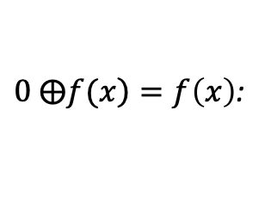
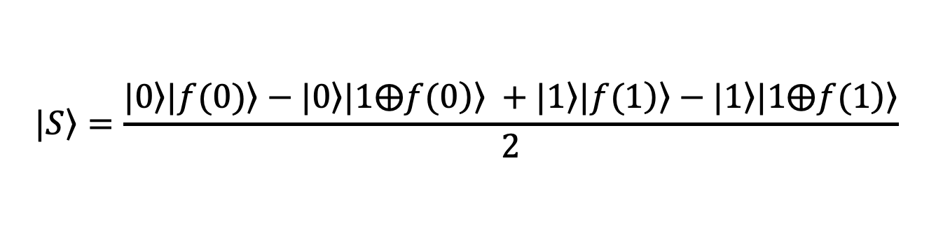
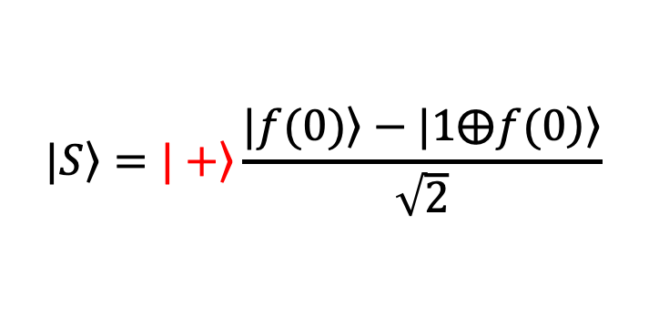
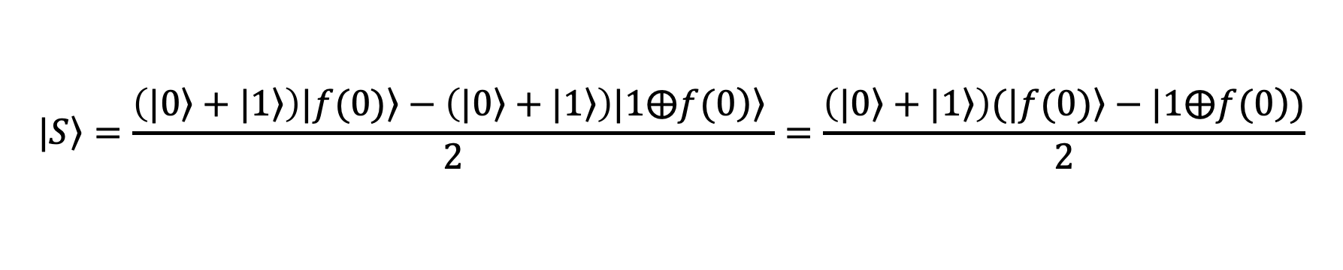
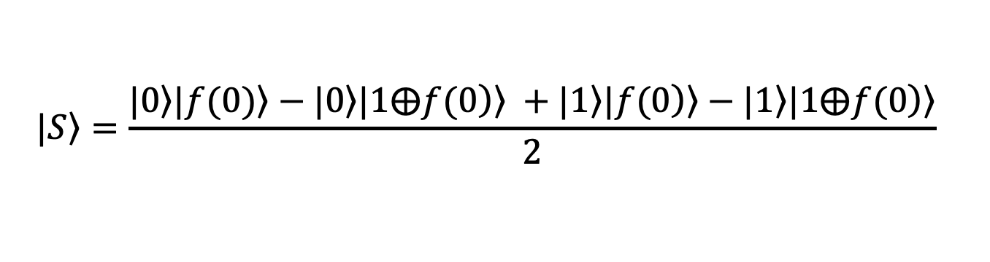
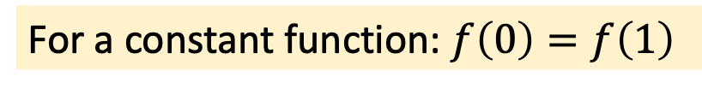
Constant Function Case
$0 ⨁\left.f(x\right)=f\left(x\right)$:
$$\left.|S\right\rangle =\frac{\left.|0\right\rangle \left.|f(0)\right\rangle −\left.|0\right\rangle \left.|1⨁\left.f(0\right)\right\rangle +\left.|1\right\rangle \left.|\left.f(1\right)\right\rangle −\left.|1\right\rangle \left.|1⨁\left.f(1\right)\right\rangle }{2}$$
H
For a constant function: $f\left(0\right)=f\left(1\right)$
$$\left.|S\right\rangle =\frac{\left.|0\right\rangle \left.|f(0)\right\rangle −\left.|0\right\rangle \left.|1⨁\left.f(0\right)\right\rangle +\left.|1\right\rangle \left.|\left.f(0\right)\right\rangle −\left.|1\right\rangle \left.|1⨁\left.f(0\right)\right\rangle }{2}$$
$$\left.|S\right\rangle =\frac{\left(\left.|0\right\rangle +\left.|1\right\rangle \right)\left.|f(0)\right\rangle −\left(\left.|0\right\rangle +\left.|1\right\rangle \right)\left.|1⨁\left.f(0\right)\right\rangle }{2}=\frac{\left(\left.|0\right\rangle +\left.|1\right\rangle \right)(\left.|f(0)\right\rangle −|1⨁\left.f(0\right))}{2}$$
$$\left.|S\right\rangle =\left.|+\right\rangle \frac{\left.|f(0)\right\rangle −\left.|1⨁\left.f(0\right)\right\rangle }{\sqrt{2}}$$
Notes:
For a constant function, where $f\left(0\right)=f\left(1\right)$, the state of the first qubit can be analyzed as follows.
The oracle’s output can be simplified by replacing$f\left(1\right)$ with $f\left(0\right)$, since they are equal.
Next, the expression is rearranged by factoring out the common term $\left(\left.|0\right\rangle +\left.|1\right\rangle \right)$.
This leaves the first qubit in the state $\left.|+\right\rangle$. After applying the Hadamard gate, it becomes $\left.|0\right\rangle$, so the measurement outcome is 0.
In other words, when the function is constant, with $f\left(0\right)=f\left(1\right)$, the algorithm correctly identifies it by producing the output 0.

Slide 13
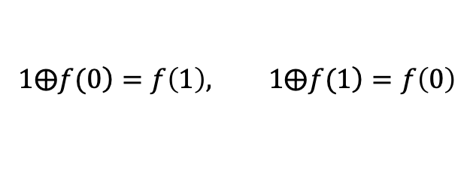
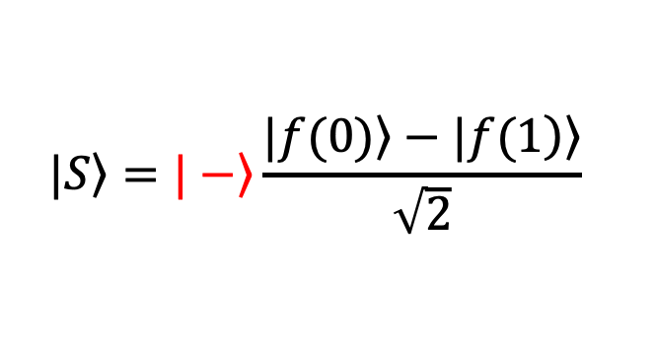
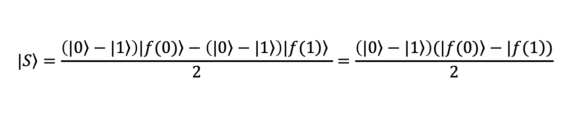
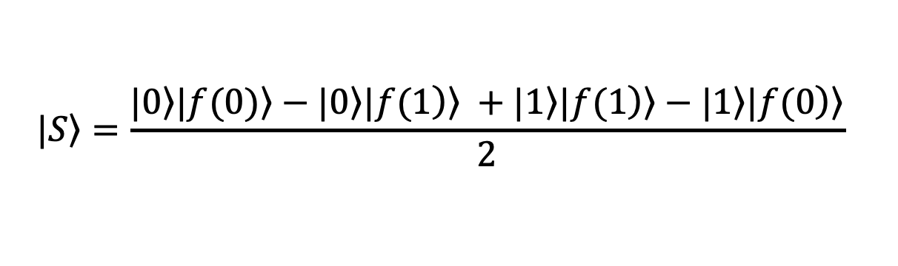
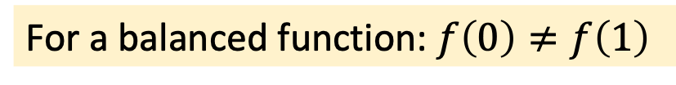
Balanced Function Case
$$\left.|S\right\rangle =\frac{\left.|0\right\rangle \left.|f(0)\right\rangle −\left.|0\right\rangle \left.|1⨁\left.f(0\right)\right\rangle +\left.|1\right\rangle \left.|\left.f(1\right)\right\rangle −\left.|1\right\rangle \left.|1⨁\left.f(1\right)\right\rangle }{2}$$
H
For a balanced function: $f\left(0\right)≠f\left(1\right)$
$$1⨁\left.f(0\right)=f\left(1\right), 1⨁\left.f(1\right)=f\left(0\right)$$
$$\left.|S\right\rangle =\frac{\left.|0\right\rangle \left.|f(0)\right\rangle −\left.|0\right\rangle \left.|\left.f(1\right)\right\rangle +\left.|1\right\rangle \left.|\left.f(1\right)\right\rangle −\left.|1\right\rangle \left.|\left.f(0\right)\right\rangle }{2}$$
$$\left.|S\right\rangle =\frac{\left(\left.|0\right\rangle −\left.|1\right\rangle \right)\left.|f(0)\right\rangle −\left(\left.|0\right\rangle −\left.|1\right\rangle \right)\left.|\left.f(1\right)\right\rangle }{2}=\frac{\left(\left.|0\right\rangle −\left.|1\right\rangle \right)(\left.|f(0)\right\rangle −|\left.f(1\right))}{2}$$
$$\left.|S\right\rangle =\left.|−\right\rangle \frac{\left.|f(0)\right\rangle −\left.|\left.f(1\right)\right\rangle }{\sqrt{2}}$$
Notes:
For a balanced function, where if $f\left(0\right)≠f\left(1\right),\text{the} \text{state} \text{of} \text{the} \text{first} \text{qubit} \text{can} \text{be} \text{analyzed} \text{as} \text{follows}\text{.}$
Since XOR with 1 flips a binary value, $1⨁\left.f(0\right)$ can be replaced by $f\left(1\right)$ and $\left.f(1\right)$ with $f\left(0\right),$ which simplifies the state.
Next, the expression is rearranged by factoring out the common term $\left(\left.|0\right\rangle −\left.|1\right\rangle \right)$.
This leaves the first qubit in the state $\left.|−\right\rangle$. After applying the Hadamard gate, it becomes ∣1⟩, so the measurement outcome is 1.
In other words, when the function is balanced, with $f\left(0\right)≠f\left(1\right)$, the algorithm correctly identifies it by producing the output 1.

Slide 14

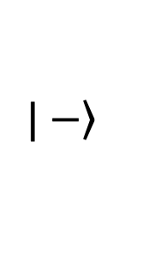
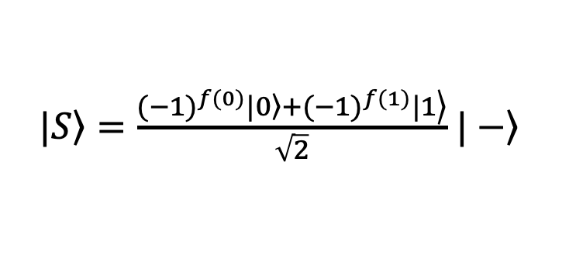
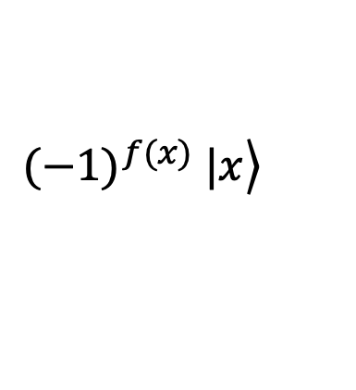
Replacing the Binary Oracle with a Phase Oracle
$$\left.|+\right\rangle \left.|−\right\rangle =\frac{\left.|0\right\rangle +\left.|1\right\rangle }{\sqrt{2}}\left.|−\right\rangle$$
$$\left.|0\right\rangle$$
H
$$\left.|x\right\rangle$$
$$\left.{(−1)}^{f(x)} |x\right\rangle$$
H
O
+
H
$$\left.|−\right\rangle$$
$$\left.|0\right\rangle$$
$$\left.|y\right\rangle =\left.|−\right\rangle$$
$\left.|S\right\rangle =\frac{{(−1)}^{f(0)}\left.|0\right\rangle +\left.{(−1)}^{f(1)}|1\right\rangle }{\sqrt{2}}$ $\left.|−\right\rangle$
Notes:
Instead of storing the function value in the auxiliary qubit, it can be encoded directly in the phase. This leads to the phase oracle.
The phase oracle applies a phase factor ${(−1)}^{f(x)}$ to the state associated with the input $x$, while leaving the auxiliary qubit y unchanged. The state at the oracle’s output is denoted by $\left.|S\right\rangle$.

Slide 15
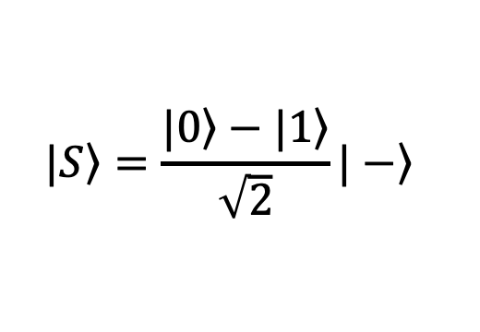
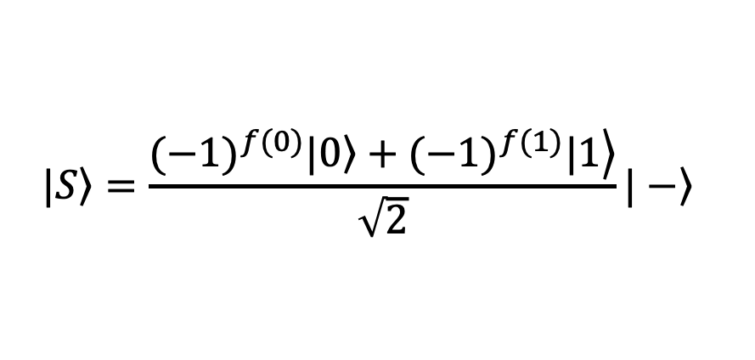
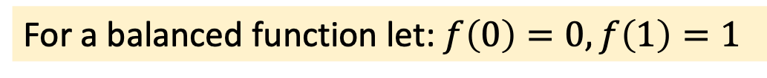
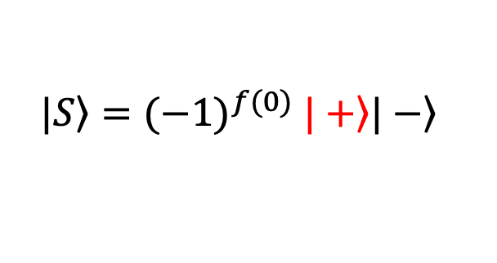
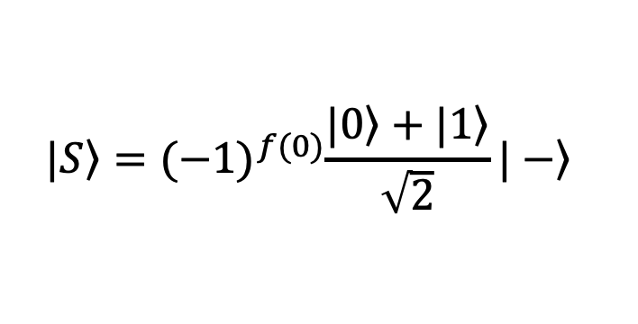
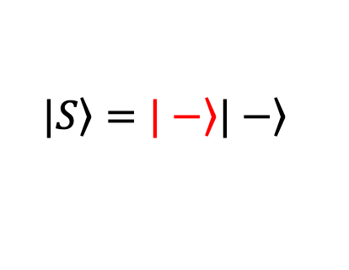


Analyzing the Phase Oracle Output
$$\left.|S\right\rangle =\frac{{(−1)}^{f(0)}\left.|0\right\rangle +\left.{(−1)}^{f(1)}|1\right\rangle }{\sqrt{2}}\left.|−\right\rangle$$
H
For a constant function: $f\left(0\right)=f\left(1\right)$
For a balanced function let: $f\left(0\right)=0, f\left(1\right)=1$
$$\left.|S\right\rangle ={(−1)}^{f(0)}\frac{\left.|0\right\rangle +\left.|1\right\rangle }{\sqrt{2}}\left.|−\right\rangle$$
$$\left.|S\right\rangle =\frac{(1)\left.|0\right\rangle +(−1)\left.|1\right\rangle }{\sqrt{2}}\left.|−\right\rangle$$
$\left.|S\right\rangle ={(−1)}^{f(0)}$ $\left.|+\right\rangle \left.|−\right\rangle$
$$\left.|S\right\rangle =\frac{\left.|0\right\rangle −\left.|1\right\rangle }{\sqrt{2}}\left.|−\right\rangle$$
$$\left.|S\right\rangle =\left.|−\right\rangle \left.|−\right\rangle$$
Notes:
The output state of the first qubit can now be examined for both constant and balanced functions.
For the constant function, after substituting $f\left(1\right)$ with $f\left(0\right)$, a common phase factor can be factored out. Since a global phase has no effect on the measurement outcome, it can simply be ignored. The first qubit is left in the state $\left.|+\right\rangle$ , which becomes ∣0⟩ after applying the Hadamard gate. So, when measured, the algorithm correctly outputs 0 for a constant function.
For a balanced function, suppose that $f\left(0\right)=0$ and $f\left(1\right)=1$. After substituting the phase factors +1 and −1, the expression simplifies, leaving the first qubit in the state∣−⟩. After applying the Hadamard gate, it becomes ∣1⟩. So, the algorithm correctly outputs 1 for a balanced function. The same applies when $f\left(0\right)=1$ and $f\left(1\right)=0$. In this case, the state of the first qubit becomes $\left.−(|0\right\rangle −\left.|1\right\rangle )/\sqrt{2}$. Since the global phase −1 has no effect on the measurement outcome, this state is physically equivalent to ∣−⟩.

Slide 16





















Experimental realizations of Deutsch’s oracle
$$\begin{matrix}x & f\left(x\right) \\ 0 & 0 \\ 1 & 0\end{matrix}$$
$$\left.|x\right\rangle$$
$$\left.|x\right\rangle$$
constant
$$f\left(x\right)=0$$
$\left.|y\right\rangle$= $\left.|0\right\rangle$
$$\left.|0\right\rangle$$
$$\begin{matrix}x & f\left(x\right) \\ 0 & 1 \\ 1 & 1\end{matrix}$$
$$\left.|x\right\rangle$$
$$\left.|x\right\rangle$$
constant
$$f\left(x\right)=1$$
$$\left.|y\right\rangle \text{= }\left.|0\right\rangle$$
+
$$\left.|1\right\rangle$$
$$\begin{matrix}x & f\left(x\right) \\ 0 & 0 \\ 1 & 1\end{matrix}$$
$$\left.|x\right\rangle$$
$$\left.|x\right\rangle$$
balanced
$$f\left(x\right)=x$$
$$\left.|y\right\rangle \text{= }\left.|0\right\rangle$$
+
$$\left.|y⨁f(x)\right\rangle$$
$$\begin{matrix}x & f\left(x\right) \\ 0 & 1 \\ 1 & 0\end{matrix}$$
$$\left.|x\right\rangle$$
$$\left.|x\right\rangle$$
balanced
$f\left(x\right)=x⨁$1
$$\left.|y\right\rangle \text{= }\left.|0\right\rangle$$
+
+
$$\left.|y⨁f(x)\right\rangle$$
Notes:
The figure shows the four possible configurations of Deutsch’s oracle.
For the constant function $f\left(x\right)=0$, the oracle consists of two direct qubit lines. The auxiliary qubit remains unchanged.
For the constant function $f\left(x\right)=1$, an X gate is applied to the auxiliary qubit, so its state is flipped regardless of the input $x$.
For the balanced function $f\left(x\right)=x$, the oracle contains a CNOT gate. The auxiliary qubit is flipped whenever $x=1$.
For the other balanced function, $f\left(x\right)=x⨁$1, an additional X gate is added to the auxiliary qubit. This implements the opposite Boolean function, where $f\left(x\right)=1$ for $x=0$ and $f\left(x\right)=0$ for $x=1$.

Slide 17
Richard Jozsa (born 1953)
David Deutsch (born 1953)
Deutsch–Jozsa algorithm
(1992)
Notes:
In 1992, David Deutsch and Richard Jozsa introduced a generalization of Deutsch’s algorithm. The Deutsch–Jozsa algorithm extends the idea to functions with multiple input bits rather than just a single bit.

Slide 18

The Deutsch–Jozsa Problem
Let $f$ be a function that maps an $n$-bit input to a single-bit output, i.e. $f:{\left\{0,1\right\}}^{n}→\left\{0,1\right\}$
It is promised that the function $f$ is either:
Constant: All outputs are the same — either all 0s or all 1s.
Balanced: Half of the inputs map to 0, and the other half to 1.
The goal is to determine whether the function $f$ is constant or balanced.
Notes:
The problem solved by the Deutsch–Jozsa algorithm can be formally stated as follows.
Let $f$ be a function that maps an $n$-bit input to a single-bit output, i.e. $$f:{\left\{0,1\right\}}^{n}→\left\{0,1\right\}$$
It is promised that the function $f$ is either:
Constant: All outputs are the same — either all 0s or all 1s.
Balanced: Half of the inputs map to 0, and the other half to 1.
The goal is to determine whether the function $f$ is constant or balanced.
In the original Deutsch problem, there were only two possible inputs, so solving it classically required at most two function evaluations. With $n$ input bits, however, there are 2^{𝑛} possible inputs. Classically, in the worst case, half of them must be checked without finding a different output. That means 2^{(𝑛−1)} evaluations may still not be enough. Only after checking one additional input can it be determined with certainty whether the function is constant or balanced. The classical deterministic solution thus requires up to 2^{(𝑛−1)}+1 function evaluations.
Just like Deutsch’s algorithm, the Deutsch–Jozsa algorithm solves the problem with only one call to the quantum oracle.
If the function is constant, quantum interference produces the output ∣00…0⟩.
If the function is balanced, the interference produces a state for which the measurement gives a non-zero bit string.
This allows a constant function to be distinguished from a balanced function with a single quantum oracle call.

Slide 19












Deutsch–Jozsa Quantum Circuit
$$\frac{1}{\sqrt{2^{n}}}\sum_{x=0}^{2^{n}−1}{{\left(−1\right)}^{\left.f(x\right)}\left.|x\right\rangle }\left.|−\right\rangle$$
$${\left.|+\right\rangle }^{⨂n}\left.|−\right\rangle =\frac{1}{\sqrt{2^{n}}}\sum_{x=0}^{2^{n}−1}{\left.|x\right\rangle }\left.|−\right\rangle$$
$$\left.|0\right\rangle$$
$$n$$
H^{⨂n}
$$\left.|x\right\rangle$$
$$\left.{\left(−1\right)}^{\left.f(x\right)} |x\right\rangle$$
H^{⨂n}
O
+
H
$$\left.|−\right\rangle$$
$$\left.|0\right\rangle$$
$$\left.|−\right\rangle$$
$$\frac{1}{\sqrt{2^{n}}}\sum_{x=0}^{2^{n}−1}{{\left(−1\right)}^{\left.f(x\right)}H^{⨂n}\left.|x\right\rangle =\frac{1}{\sqrt{2^{n}}}\sum_{x=0}^{2^{n}−1}{{\left(−1\right)}^{\left.f(x\right)}}\frac{1}{\sqrt{2^{n}}}\sum_{k=0}^{2^{n}−1}{{\left(−1\right)}^{x∙k}\left.|k\right\rangle }}$$
$$x∙k=x_{0}k_{0} {⨁x}_{1}k_{1}⋯$$
Notes:
The Deutsch–Jozsa circuit uses the same type of oracle as Deutsch’s algorithm, but this time the input is an$n$-qubit register.
After preparing the input registers:
the upper register $x$ contains $n$ qubits in an equal superposition of all possible inputs,
the lower register $y$ is prepared in the ∣−⟩ state.
The oracle then applies phase kickback to the upper register. It flips the phase of every basis state $\left.|x\right\rangle$ for which which $\left.f(x\right)=1$.
Hadamard gates are then applied to the upper register, combining the amplitudes of the different basis states and creating quantum interference determined by $\left.f(x\right)$.

Slide 20




Deutsch–Jozsa Algorithm: Constant Function
$$\left.|S\right\rangle =\frac{1}{\sqrt{2^{n}}}\sum_{x=0}^{2^{n}−1}{{\left(−1\right)}^{\left.f(x\right)}}\frac{1}{\sqrt{2^{n}}}\sum_{k=0}^{2^{n}−1}{{\left(−1\right)}^{x∙k}\left.|k\right\rangle =}\frac{1}{2^{n}}\sum_{x=0}^{2^{n}−1}{\sum_{k=0}^{2^{n}−1}{{\left(−1\right)}^{\left.f(x\right)}}{\left(−1\right)}^{x∙k}\left.|k\right\rangle }$$
$$n$$
$$p\left(0⋯0\right)=?$$
$$\left.|S\right\rangle =\frac{1}{2^{n}}\sum_{x=0}^{2^{n}−1}{{{(−1)}^{f(x)}(−1)}^{x∙0}}\left|0⋯0\right\rangle =\frac{1}{2^{n}}\sum_{x=0}^{2^{n}−1}{{\left(−1\right)}^{\left.f(x\right)}}\left|0⋯0\right\rangle$$
$$p_{0}={\left|\frac{1}{2^{n}}\sum_{x=0}^{2^{n}−1}{{\left(−1\right)}^{f(x) }}\right|}^{2}={\left|\frac{{±2}^{n}}{2^{n}}\right|}^{2}=1$$
Notes:
The expression for the upper register describes the interference pattern. Each basis state $\left.|k\right\rangle$ receives contributions with either a plus or minus sign, determined by the function value $\left.f(x\right)$ and the inner product $x∙k$, which comes from the action of the Hadamard gates. The way these contributions reinforce or cancel each other allows the algorithm to distinguish between constant and balanced functions. Since a constant function should produce the output ∣0⋯0⟩, the next step is to determine the probability of measuring this state.
For $\left.|k\right\rangle =\left.|0⋯0\right\rangle$, the inner product $x∙k=x∙0$ is always 0.
The amplitude of $\left|0⋯0\right\rangle$ is determined by the sum of the phase factors ${\left(−1\right)}^{f(x) }$.
If $f\left(x\right)$ it is either always 0 or always 1. Therefore, all terms in the sum are either +1 or all are −1, giving ${\sum_{x}{{\left(−1\right)}^{f(x) }=}±2}^{n}$
After normalization, the amplitude is $±1$, and its squared magnitude gives p(0⋯0)=1. So, for a constant function, the upper register is measured as $\left.|0⋯0\right\rangle$ with certainty.

Slide 21




Deutsch–Jozsa Algorithm: Balanced Function
$$\left.|S\right\rangle =\frac{1}{\sqrt{2^{n}}}\sum_{x=0}^{2^{n}−1}{{\left(−1\right)}^{\left.f(x\right)}}\frac{1}{\sqrt{2^{n}}}\sum_{k=0}^{2^{n}−1}{{\left(−1\right)}^{x∙k}\left.|k\right\rangle =}\frac{1}{2^{n}}\sum_{x=0}^{2^{n}−1}{\sum_{k=0}^{2^{n}−1}{{\left(−1\right)}^{\left.f(x\right)}}{\left(−1\right)}^{x∙k}\left.|k\right\rangle }$$
$$n$$
$$p\left(0⋯0\right)=?$$
one half of the inputs:
$$f\left(x\right)=0⇒{(−1)}^{f(x)}=1$$
the other half of the inputs:
$$f\left(x\right)=1⇒{(−1)}^{f(x)}=−1$$
$$p_{0}={\left|\frac{1}{2^{n}}\sum_{x=0}^{2^{n}−1}{{\left(−1\right)}^{\left.f(x\right)}}\right|}^{2}={\left|\frac{1}{2^{n}}\left(1+⋯+1\right)+\left(−1−⋯−1\right)\right|}^{2}={\left|\frac{0}{2^{n}}\right|}^{2}=0$$
Notes:
Since measuring ∣0⋯0⟩ with probability 1 indicates that the function is constant, a probability of 0 for this outcome indicates that the function is balanced. To confirm this, the probability of measuring ∣0⋯0⟩ can be calculated for a balanced function.
For a balanced function, half of the inputs satisfy $f\left(x\right)=0$, giving phase factors ${(−1)}^{f(x)}=1$.
For the other half, $f\left(x\right)=1$, giving phase factors ${(−1)}^{f(x)}=−1$.
The positive and negative contributions cancel each other, so their total sum is 0.
This makes the amplitude of ∣0⋯0⟩ equal to 0, and consequently $P\left(0⋯0\right)=0$. This confirms that for a balanced function, the outcome ∣0⋯0⟩ never appears.
In conclusion, the algorithm rules out the constant case and identifies the function as balanced.

Slide 22


Experimental circuit for verifying the Deutsch–Jozsa algorithm (n = 3)
$$x$$ | $$f(x)$$
$$000$$ | $$0$$
$$001$$ | $$1$$
$$010$$ | $$1$$
$$011$$ | $$0$$
$$100$$ | $$1$$
$$101$$ | $$0$$
$$110$$ | $$0$$
$$111$$ | $$1$$
Notes:
The figure shows an experimental circuit used to test whether the Deutsch–Jozsa algorithm can recognize a balanced function for bit strings of length 3. The oracle, built using three CNOT gates, implements a balanced function: half of the inputs produce the output 0, while the other half produce the output 1, as shown in the truth table.
This oracle is then placed inside the Deutsch–Jozsa circuit, and the upper register is prepared in a superposition of all possible inputs. After running the circuit, the measurement result is 111. Since this result is different from 000, the algorithm correctly identifies the function as balanced.

Slide 23
Bernstein – Vazirani algorithm
(1993)
Umesh Vazirani
(born 1959)
Notes:
In 1993, Professor Umesh Vazirani and his student Ethan Bernstein published a paper on the complexity theory of quantum algorithms. In this work, they introduced an algorithm that can determine an unknown binary string.
Although originally introduced as a theoretical example, the Bernstein–Vazirani algorithm became an important demonstration of how quantum computation can extract hidden information more efficiently than a classical approach.

Slide 24





Bernstein–Vazirani: The Hidden String Problem
0,1,2,3
4,5,6,7
?
Forgotten password: $s_{0}s_{1}s_{2}=101=5$
$$\begin{matrix}x_{0}x_{1}x_{2}=100→y=1 \\ x_{0}x_{1}x_{2}=010→y=0 \\ x_{0}x_{1}x_{2}=001→y=1\end{matrix}$$
$$101=5$$
$$y=f(x)=\left({ x}_{0}∙s_{0}\right) ⨁\left({ x}_{1}∙s_{1}\right)⨁\left({ x}_{2}∙s_{2}\right)$$
Notes:
The problem solved by the Bernstein–Vazirani algorithm can be informally described as follows.
Alice sets her phone password to a single digit between 0 and 7, but then forgets it. If she guesses one number at a time, it could take up to 8 tries, or about 4–5 tries on average. With a 4-digit password (0000–9999), it could take up to 10,000 tries. But there is a smarter way: instead of guessing the whole number, Alice can represent the password in binary and determine it one bit at a time.
Suppose the phone has a secure chip that acts as an oracle. It knows the password, but for security reasons it cannot reveal it directly. Instead, the oracle accepts a 3-bit input and returns 1 or 0 depending on whether the selected position contains a 1 in the password. Alice sends input bit strings containing exactly one 1, such as 100, 010, and 001, probing each position separately.
Suppose the forgotten password is the number 5, represented by the 3-bit string $s_{0}s_{1}s_{2}=101$. To retrieve the password, Alice sends three queries: 100,010,001. The oracle returns 1, 0, and 1, respectively. Putting these results together gives 101, revealing that the first and third bits of the password are 1. With only three queries, Alice has retrieved the password. In general, finding an unknown n-bit string in this way requires n classical queries, giving a query complexity of $O(n)$.
More generally, the function computed by the oracle can be written as the bitwise inner product modulo 2 of the input string $x$ and the hidden string $s$:
$$f\left(x\right)=x∙s=\left({ x}_{0}∙s_{0}\right) ⨁\left({ x}_{1}∙s_{1}\right)⨁\left({ x}_{2}∙s_{2}\right)$$
The Bernstein–Vazirani algorithm uses quantum superposition and interference to determine the entire hidden string $s$ with just one oracle query.

Slide 25

The Bernstein–Vazirani Problem
Let $f:{\left\{0,1\right\}}^{n}→\left\{0,1\right\}$ be a function that maps an $n$-bit input string $x=x_{0}x_{1}⋯x_{n−1}$
to a single-bit output, defined as the bitwise inner product modulo 2
$$f\left(x\right)=x∙s (mod 2)=\left({ x}_{0}∙s_{0}\right) ⨁ \left({ x}_{1}∙s_{1}\right) ⨁ ⋯ ⨁ \left({ x}_{n−1}∙s_{n−1}\right)$$
The task is to determine the unknown bitstring $s \text{using} \text{as} \text{few} \text{queries} \text{to} f$ as possible.
Notes:
The problem solved by the Bernstein–Vazirani algorithm can be formally stated as follows:
Let $f:{\left\{0,1\right\}}^{n}→\left\{0,1\right\}$ be a function that maps an $n$-bit input string $x=x_{0}x_{1}⋯x_{n−1}$ to a single-bit output, defined as the bitwise inner product modulo 2
$$f\left(x\right)=x∙s (mod 2)=\left({ x}_{0}∙s_{0}\right) ⨁ \left({ x}_{1}∙s_{1}\right) ⨁ ⋯ ⨁ \left({ x}_{n−1}∙s_{n−1}\right)$$
The task is to determine the unknown bit string $s∈{\left\{0,1\right\}}^{n}$ using as few queries to $f$ as possible.

Slide 26
Bernstein–Vazirani Quantum Circuit
Notes:
Bernstein and Vazirani showed that, on a quantum computer, an unknown binary string can be determined with a single query, provided that the oracle computes the bitwise inner product.
The figure illustrates the quantum circuit for this algorithm. The oracle, which computes the inner product function, is implemented using two controlled-X (CNOT) gates. The control qubits correspond to the positions of the 1s in the secret string, in this case, 101.
The input qubits are initialized in an equal superposition of all possible inputs, so the oracle acts on all of these inputs in superposition. The target qubit y is initialized in the ∣−⟩ state. This causes phase kickback, introducing a phase factor ${\left(−1\right)}^{x}$ for each input state. These phase changes encode the hidden string into the input register, allowing it to be retrieved after the final Hadamard gates.

Slide 27

Bernstein–Vazirani: the quantum approach
$$x_{0}y: \begin{matrix}\left.|+\right\rangle \left.|−\right\rangle = & \frac{\left|0\right\rangle +\left|1\right\rangle }{\sqrt{2}}\frac{\left|0\right\rangle −\left|1\right\rangle }{\sqrt{2}}=\frac{\left|00\right\rangle −\left|01\right\rangle +\left|10\right\rangle −\left|11\right\rangle }{2} \\ \underset{→}{cX} & \frac{\left|00\right\rangle −\left|01\right\rangle +\left|11\right\rangle −\left|10\right\rangle }{2}=\frac{\left|0\right\rangle −\left|1\right\rangle }{\sqrt{2}}\frac{\left|0\right\rangle −\left|1\right\rangle }{\sqrt{2}} \\ = & \left.|−\right\rangle \left.|−\right\rangle \end{matrix}$$
Notes:
As an example, the combined state of qubits $x_{0}$​ and $y$ can be followed through the circuit.
After applying the Hadamard gates, the qubits $x_{0}$​ and $y$ enter the oracle in the state $\left.|+\right\rangle \left.|−\right\rangle$.
By expanding these two superpositions and applying the CNOT gate, with $x_{0}$​ as the control and $y$ as the target, the output state becomes $\left.|−\right\rangle \left.|−\right\rangle$.
This shows that phase kickback has occurred, changing the state of qubit $x_{0}$​ from $\left.|+\right\rangle$ to $\left.|−\right\rangle$.
Applying a Hadamard gate to $\left.|−\right\rangle$ gives ∣1⟩, revealing a 1 at the position corresponding to $x_{0}$​.
For qubit $x_{1}$​, which does not control a CNOT gate in the oracle, the state remains $\left.|+\right\rangle$.
After the final Hadamard gate, $\left.|+\right\rangle$ becomes $\left.|0\right\rangle$, revealing a 0 at this position.
Finally, measuring the input register reveals the complete secret string.

Slide 28








Bernstein–Vazirani Algorithm: General Circuit
$$\frac{1}{\sqrt{2^{n}}}\sum{\left.|x\right\rangle \left.|−\right\rangle }$$
$$\frac{1}{\sqrt{2^{n}}}\sum{{\left(−1\right)}^{\left.f(x\right)} \left.|x\right\rangle \left.|−\right\rangle =\frac{1}{\sqrt{2^{n}}}\sum{\left.{\left(−1\right)}^{x∙s}|x\right\rangle \left.|−\right\rangle }}$$
$$\left.|0\right\rangle$$
H^{⨂n}
$$\left.|x\right\rangle$$
$${\left(−1\right)}^{\left.f(x\right)}\left.|x\right\rangle$$
H^{⨂n}
O
+
H
$$\left.|−\right\rangle$$
$$\left.|−\right\rangle$$
$$\left.|0\right\rangle$$
$$\frac{1}{\sqrt{2^{n}}}\sum_{x}{{\left(−1\right)}^{x∙s}}\frac{1}{\sqrt{2^{n}}}\sum_{k}{{\left(−1\right)}^{x∙k}}\left.|k\right\rangle =\frac{1}{2^{n}}\sum{\left(\sum{{\left(−1\right)}^{\left(s⨁{k}\right)∙x}}\right)}\left.|k\right\rangle$$
$$k$$
x
for $k=s$ probability of measuring $k=s$ is 1!
Notes:
The quantum circuit shown is a general implementation of the Bernstein–Vazirani algorithm. Its overall structure is identical to the circuit used in the Deutsch–Jozsa algorithm. However, because the oracle function, the problem being solved, and the expected outcomes are different, the results are fundamentally different.
The circuit has two registers:
The upper register contains $n$ qubits, initialized to ${\left.|0\right\rangle }^{⨂n}$.
The lower register contains a single qubit, initialized to $\left.|0\right\rangle$.
After applying Hadamard gates, the upper register is placed in an equal superposition of all possible inputs.
A combination of X and Hadamard gates prepares the lower qubit in the ∣−⟩ state, enabling phase kickback..
As the oracle applies phase kickback, each basis state $\left.|x\right\rangle$ in the upper register acquires a phase factor ${\left(−1\right)}^{\left.f(x\right)}$ where $\left.f(x\right)=x∙s$ is the bitwise inner product modulo 2 between the input $x$ and the hidden string $s$.
Next, Hadamard gates are applied again to the upper register. The resulting state can be expressed as a double sum: one over all $x$, arising from the initial superposition, and another over all $k$, arising from the final Hadamard transformation. The inner sum determines the amplitude associated with each possible output state $\left.|k\right\rangle$.
For $k=s$, the term $s⨁{k}$ becomes the all-zero string, so $\left(s⨁{k}\right)∙x=0$ for every $x$ and the inner sum evaluates to $2^{n}$. After accounting for the normalization factor ${1/2}^{n}$, the state amplitude is 1. The hidden string $s$ is therefore obtained with probability 1.
For $k≠s$, , the function $\left(s⨁{k}\right)∙x$ is balanced as $x$ ranges over all possible $n$-bit strings. The sum therefore contains equal numbers of +1 and −1 contributions, which cancel through destructive interference. As a result, the amplitude of every state $\left.|k\right\rangle \left.≠|k\right\rangle$is zero.
In conclusion, the Bernstein–Vazirani algorithm returns the hidden string s with certainty using a single oracle query.

Slide 29


Practical implementation of the Bernstein–Vazirani algorithm
$$s=110$$
$$x∙s \left(mod 2\right)$$
Notes:
The figure shows a practical implementation of the Bernstein–Vazirani algorithm for identifying the hidden bit string 110. This string is encoded in the oracle using two CNOT gates, with control qubits corresponding to the positions of the 1s in the hidden string s.
On the right-hand side, the measurement probability diagram shows that the Bernstein–Vazirani algorithm has correctly recovered the hidden string. Note that the histogram displays 011 instead of 110 because of the little-endian convention used to display the measurement results.

Slide 30

Simon’s algorithm
(1993)
Daniel Simon
Notes:
In 1993, Daniel Simon introduced another algorithm that demonstrated a significant advantage of quantum computation over classical computation. Like the previously discussed algorithms, Simon’s algorithm also deals with functions that map binary strings.
As often happens in science, Simon’s 1993 paper was initially rejected by a leading conference in the field. A year later, after resubmission and with the encouragement of a colleague, it was accepted at another conference. Today, Simon’s algorithm is recognized as a milestone in quantum computing because it demonstrated an exponential advantage over classical approaches for a specific problem and provided an important conceptual foundation for Shor’s algorithm.

Slide 31
Simon’s Algorithm: Informal Problem Description
2
1
3
0
4
f(x) = f(x⨁s)
5
5
2
0
6
6
0
6
5
2
Notes:
The problem solved by Simon’s algorithm can be informally described as follows.
Imagine a black-box machine (an oracle) that takes binary strings as inputs and produces binary strings as outputs. As different inputs are tested, an interesting pattern appears: pairs of different inputs produce the same output. The challenge is to discover the hidden relationship between these pairs.
The oracle computes a function $f(x)$ that satisfies $f(x)=f(x ⨁ s)$, where s is an unknown binary string. This means that two inputs separated by the hidden XOR pattern $s$ produce the same output. The goal of Simon’s algorithm is to determine this hidden string s.

Slide 32

Simon’s Algorithm: Formal Problem Definition
Given a function $f:{\left\{0,1\right\}}^{n}→{\left\{0,1\right\}}^{n}$
that maps an $n$-bit input to an $n$-bit output, find a string $s∈{\left\{0,1\right\}}^{n}$ such that
$f(x)=f(x ⨁ s)$ for all $x∈{\left\{0,1\right\}}^{n}$
Notes:
Formally, Simon’s problem is defined as follows.
Given a function $f:{\left\{0,1\right\}}^{n}→{\left\{0,1\right\}}^{n}$, the task is to find a binary string $s∈{\left\{0,1\right\}}^{n}$ such that $f(x)=f(x ⨁ s)$ for all $x∈{\left\{0,1\right\}}^{n}$.
The function $f$ is promised to satisfy one of the following two conditions:
One-to-one: $f(x)$ maps each input $x$ to a unique output, or
Two-to-one with hidden period: There exists a non-zero bit string $s≠0^{n}$ such that for every input $x$, the function satisfies $f(x)=f(x ⨁ s)$ and the only two inputs that produce the same output are $x$ and $x ⨁ s$.
In other words, the function is either one-to-one, corresponding to $s=0^{n}$, or it has a non-zero hidden string $s$, in which case each output corresponds to exactly two inputs that differ by $s$ .

Slide 33



Simon’s Algorithm: Classical Solution
$$x$$ | $$f(x)$$
000 | 101
001 | 010
010 | 000
011 | 110
100 | 000
101 | 110
110 | 101
111 | 010
$$\left.f(x_{i})=f(x_{j})=f(x_{i}⨁s\right)$$
$$x_{j}=x_{i}⨁ s$$
$${x_{i}⨁x}_{j}={x_{i}⨁x}_{i}⨁ s=s$$
$$s=x_{i}⨁x_{j}=001 ⨁ 111=110$$
Notes:
In the classical setting, solving Simon’s problem involves identifying two distinct inputs that produce the same output under the function $f$. The classical algorithm relies on comparing output values for different inputs until such a collision is found.
To identify the hidden string, a simple table of inputs and outputs can be constructed. Looking at the table, some outputs appear twice. For example, the inputs 001 and 111 both produce the same output 010, and the same pattern occurs for other pairs of inputs.
In a classical approach, the computer evaluates the function for different inputs until it finds two inputs that produce the same output. Suppose a collision is found for two inputs $x_{i}$​ and $x_{j}$​, such that $f(x_{i})=f(x_{j})$. Since Simon’s promise tells us that $x_{j}=x_{i}⨁ s$, XOR-ing both sides with $x_{i}$​ gives $s=x_{i}⨁x_{j}$. In other words, the hidden string s can be found by XOR-ing two different inputs that produce the same output.
In the example from the table, $s=x_{i}⨁x_{j}=001 ⨁ 111=110$

Slide 34








Complexity analysis of the classical approach
$$\frac{m\left(m−1\right)}{2}≈\frac{m^{2}}{2}$$
1. Select $m$ random $n$-bit inputs
unique pairs
2. A collision becomes likely when the number of pairs
is comparable to the size of the input space
$$m^{2} \sim 2^{n}$$
$$m$$
3. Solve for m
$$m \sim \sqrt{2^{n}}$$
$$x$$
$$f(x)$$
$$O\left(\sqrt{2^{n}}\right)=O(2^{n/2})$$
classical query complexity
Notes:
In a simple classical approach, input-output pairs are examined one by one until two different inputs producing the same output are found.
A more efficient classical approach is to randomly select $m$ inputs. Since each input is an $n$-bit string, there are $2^{n}$ possible inputs. The $m$ selected inputs form
$$\frac{m\left(m−1\right)}{2}$$
unique pairs, which grows approximately as $m^{2}$. A collision is expected when the number of these pairs becomes comparable to the number of possible n-bit inputs, $2^{n}$.
This gives $m^{2}≈2^{n}$ and therefore $m≈\sqrt{2^{n}}$. The classical query complexity is therefore $O\left(\sqrt{2^{n}}\right)=O(2^{n/2})$. The classical query complexity is exponential in the number of input bits $n$. This means that the number of required queries grows very rapidly as $n$ increases.

Slide 35











Simon’s Algorithm: Quantum Part (1)
$$\frac{1}{\sqrt{2^{n}}}\sum{{\left.\left.|x\right\rangle |0\right\rangle }^{⊗n}}$$
$$\frac{1}{\sqrt{2^{n}}}\sum{\left.|x\right\rangle \left.|f(x)\right\rangle }$$
$$n$$
H^{⨂n}
$$x$$
$$\left.|0\right\rangle$$
H^{⨂n}
$$\left.|x\right\rangle$$
$$\left.|x\right\rangle$$
O
$$n$$
$$z$$
$$\left.|0\right\rangle$$
$$\left.|0\right\rangle$$
$$\left.|f(x)\right\rangle$$
$$\frac{\left.|x_{0}\right\rangle +\left.|x_{0} ⨁ s\right\rangle }{\sqrt{2}}\left.|{f(x}_{0})\right\rangle$$
Notes:
Simon’s algorithm offers a more efficient solution to the problem by combining quantum and classical steps. In the quantum part, the oracle is queried on a superposition of all possible inputs. Measuring the function output collapses the input register into a superposition of two states, $\left.|x_{0}\right\rangle$ and $\left.|x_{0} ⨁ s\right\rangle$, corresponding to inputs that produce the same output. Further quantum processing and measurement produce a bit string that provides an equation involving the hidden string $s$. Repeating this process several times provides enough equations for the classical part of the algorithm to recover $s$.
The quantum circuit for Simon’s algorithm consists of two registers, each containing 𝑛 qubits.
The first register, 𝑥, is initialized in the state and serves as the input to the oracle that computes 𝑓(𝑥).
The second register, 𝑧, is also initialized in the state ${\left.|0\right\rangle }^{⊗n}$ .
In the first step, Hadamard gates are applied to all qubits in the 𝑥-register, creating an equal superposition of all possible 𝑛-bit inputs. The overall state is then the tensor product of this superposition and the initial ${\left.|0\right\rangle }^{⊗n}$ state of the 𝑧-register.
After the oracle is applied, the two registers become entangled: the 𝑥-register contains all possible inputs in superposition, while the 𝑧-register contains their corresponding function values 𝑓(𝑥).
Next, the 𝑧-register is measured, producing a particular function value 𝑓(𝑥₀). As a result, the 𝑥-register collapses into a superposition of exactly two states $\left.|x_{0}\right\rangle$ and $\left.|x_{0} ⨁ s\right\rangle$corresponding to the two inputs that produce the same output 𝑓(𝑥₀).

Slide 36






Simon’s Algorithm: Quantum Part (2)
$$\frac{\left.|x_{0}\right\rangle +\left.|x_{0} ⨁ s\right\rangle }{\sqrt{2}}$$
$$H^{⊗n}\frac{\left.|x_{0}\right\rangle +\left.|x_{0} ⨁{ }s\right\rangle }{\sqrt{2}}$$
$$=\frac{1}{\sqrt{2^{n+1}}}\sum_{y∈{\left\{0,1\right\}}^{n}}{\left[{\left(−1\right)}^{x_{0}∙y}+{\left(−1\right)}^{(x_{0}⨁s)∙y}\right]}\left.|y\right\rangle$$
H^{⨂n}
$$=\frac{1}{\sqrt{2^{n+1}}}\sum_{y∈{\left\{0,1\right\}}^{n}}{{\left(−1\right)}^{x_{0}∙y}\left[1+{\left(−1\right)}^{s∙y}\right]}\left.|y\right\rangle$$
$$1+{\left(−1\right)}^{s∙y}=\left\{\begin{matrix}\begin{matrix}0 & when s∙y=1 & \\ 2 & when s∙y=0 & ⇒\frac{1}{\sqrt{2^{n−1}}}\sum_{s∙y=0}{{\left(−1\right)}^{x_{0}∙y}}\left.|y\right\rangle \end{matrix} & \\ & \end{matrix}\right.$$
Notes:
To find the hidden string 𝑠, the focus is now only on the 𝑥-register. After measuring the other register, the 𝑥-register is left in a superposition of two states: 𝑥₀ and 𝑥₀ ⨁ 𝑠.
When the Hadamard transform is applied to the 𝑥-register, , the probability amplitudes associated with these two states interfere.
From the resulting expression, two cases can be identified:
If 𝑠·𝑦 = 1, destructive interference occurs, and the probability of measuring that state is zero.
If 𝑠·𝑦 = 0, constructive interference occurs, and the probability of measuring that state is nonzero.
Therefore, the only measurement outcomes that can appear are the bit strings 𝑦 that satisfy
$$s∙y=0 (mod 2)$$

Slide 37









Simon’s Algorithm: Classical Part
$$\frac{1}{\sqrt{2^{n−1}}}\sum_{s∙y=0}{{\left(−1\right)}^{x_{0}∙y}}\left.|y\right\rangle$$
$$\begin{matrix}y_{1}∙s=0 \\ y_{2}∙s=0 \\ ⋮ \\ y_{k}∙s=0\end{matrix}$$
$y_{1},y_{2}$, . . ., $y_{k}$
for
$$y∙s=0$$
gives
$$y∙s =\left({ y}_{0}∙s_{0}\right) ⨁ \left({ y}_{1}∙s_{1}\right) ⋯=0$$
Example
$y_{1}$=001
$y_{2}$=111
$$y_{1}∙s=\text{001}∙s=0$$
$$y_{2}∙s=111∙s=0$$
$$y_{1}∙s=\text{001}∙s=\left(0∙s_{2}\right) ⨁ \left(0∙s_{1}\right) ⨁ \left(1∙s_{0}\right)=0 ⨁ 0 ⨁ \left(1∙s_{0}\right)\left(1∙s_{0}\right)=\left(1∙s_{0}\right)=0$$
$y_{2}∙s=111∙s=\left(1∙s_{2}\right) ⨁ \left(1∙s_{1}\right) ⨁ \left(1∙s_{0}\right)=\left(1∙s_{2}\right) ⨁ \left(1∙s_{1}\right) ⨁ 0=$ $\left(1∙s_{2}\right) ⨁ \left(1∙s_{1}\right)=0$
If $s_{2}=s_{1}=0$, then $s=000$
If $s_{2}=s_{1}=1$, then $s=110$
$$s_{0}=0,$$
Notes:
To determine the bits of the hidden string $s$, several measurement results $y$ need to be collected. This is why Simon’s algorithm is run multiple times. For each measurement outcome $y_{i}$i​, an equation of the form
$$y_{i}∙ s =0 (mod 2)$$
is obtained, gradually building a system of linear equations. Each new result is checked to determine whether it provides new information or can be expressed as a linear combination of previous results. For example, if 𝑦₃ = 𝑦₁ ⨁ 𝑦₂, then 𝑦₃ is redundant
To determine a nonzero hidden string $s$, $n−1$ linearly independent equations are required, where $n$ is the number of bits in $s$. Once enough independent equations have been collected, the system is solved classically to recover $s$.
For example, suppose two measurements produce $y_{1}$=001 and $y_{2}$=111. These give two linear Boolean equations.
Each equation represents a bitwise inner product: corresponding bits of $y$ and $s$ are multiplied, and the results are summed modulo 2
For $s=s_{2}s_{1}s_{0}$, the first equation gives $\text{001}∙s=s_{0}=0$. The second equation gives $111∙s=s_{2}⨁s_{1}⨁s_{0}$. Since $s_{0}=0$, $s_{2}⨁s_{1}=0$, giving two possible solutions: $s_{2}=s_{1}=0$ giving $s=000$ $s_{2}=s_{1}=\text{1} \text{giving} s=110$
Since the nonzero hidden string is being sought, the solution is $s=110$.

Slide 38

Questions?

